Slide 1
Topology optimization of 2D structures with nonlinearities using deep learning
Diab W. Abueidda a,b,c, Seid Koric a,b, Nahil A. Sobh
Presented by Fangxiao Jin
SCUT Machine Intelligence Laboratory
Nov 25, 2021

Slide 2
Contents
1
Background
2
Motivation
3
Proposed Method
4
Experimental Results
5
Conclusion

Slide 3
Contents
1
Background
2
Motivation
3
Proposed Method
4
Experimental Results
5
Conclusion

Slide 4
Introduction
Designing the architectures of materials is still an active area of research, as it allows for obtaining unique properties.
With the availability of cloud computing, searching for optimal nonlinear structures is now within reach.
Topology optimization offers a systematic platform for obtaining new designs of materials and structural systems with optimized responses.
Identifying the optimal material distribution yielding the desired properties, while still, the design constraints are satisfied.;
Problems involving many load cases.

Slide 5
Trouble of Topology Optimization
Topology optimization problems are very computationally expensive due to a large number of design variables and the need for many optimization iterations.
Gradient-based topology optimization algorithms may suffer from the dependency on the starting point, given that multiple local optima exist.

Slide 6
Contents
1
Background
2
Motivation
3
Proposed Method
4
Experimental Results
5
Conclusion

Slide 7
ML in Topology Optimization
The implementation of machine learning algorithms in topology optimization has been limited to design spaces with linear elastic materials undergoing small deformation, with linear optimization constraints.
Geometric and material nonlinearities significantly influence the solution of the optimization, provided that the loads are large enough to onset system nonlinearities.
So this paper develops ML models that perform a real-time topology optimization of materials under large deformation and small deformation (with and without stress constraint).
The primary objective of this paper is to develop deep CNN models to solve topology optimization problems.

Slide 8
Three CNN Models
The first model assumes linear elastic material and small deformations without stress constraint.
The second model accounting for large deformations with linear elastic material is developed for materials obeying the hyperelastic neo-Hookean constitutive model. (non-linear)
The third CNN model assumes a linear elastic material under a stress constraint.

Slide 9
Contents
1
Background
2
Motivation
3
Proposed Method
4
Experimental Results
5
Conclusion

Slide 10
Elasticity and Hyperelasticity
Firstly, two CNN models are developed, one for a linear elastic material and another for a neo-Hookean rubber-like material.
Each dataset is composed of many pairs of optimized designs and their corresponding boundary conditions, loads, and volume constraints.
In this study, the proposed framework is illustrated using a single concentrated force while fixed displacements are imposed.
The data generated for each case are split into training (81%), validation (9%), and testing (10%) datasets.

Slide 11
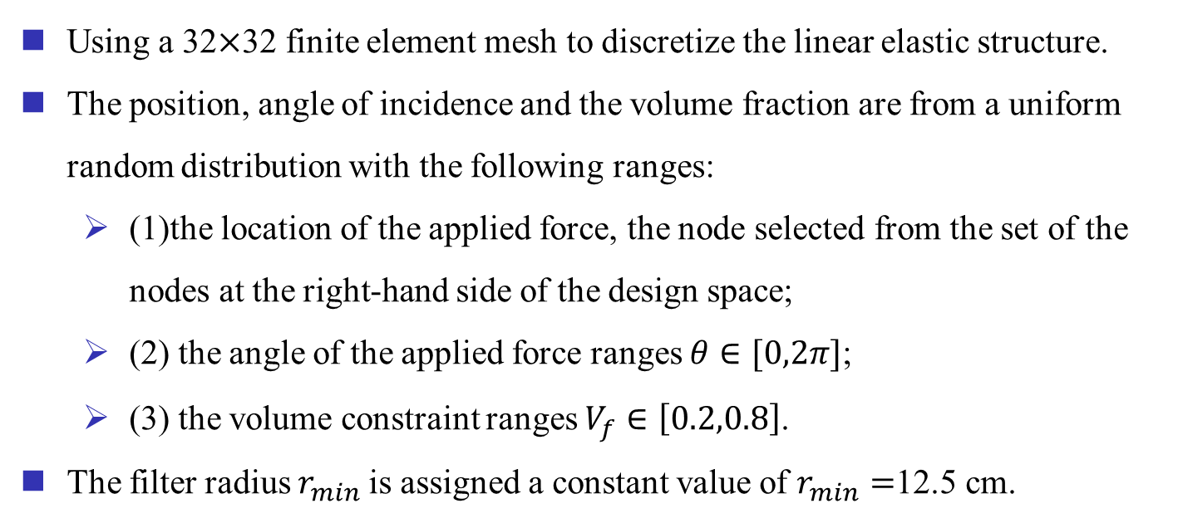
Dataset For Linear Elastic Structure
Using a 32$×$32 finite element mesh to discretize the linear elastic structure.
The position, angle of incidence and the volume fraction are from a uniform random distribution with the following ranges:
(1)the location of the applied force, the node selected from the set of the nodes at the right-hand side of the design space;
(2) the angle of the applied force ranges $θ∈[0,2π]$;
(3) the volume constraint ranges $V_{f}∈\left[0.2,0.8\right]$.
The filter radius $r_{min}$is assigned a constant value of $r_{min}=$12.5 cm.

Slide 12
Further Steps
For each data point in the dataset, the three parameters are randomly selected using uniform distribution functions available in the open-source package Python.
Then, these parameters are automatically fed to the ABAQUS environment to generate the mesh, assign the boundary conditions and loads, define material properties, create the optimization problem with desired optimization parameters.
Afterward, the optimized designs are saved to a text file, including all required information (input and output).
A total of 15,000 data pairs were generated using the iForge HPC cluster hosted at the National Center for Supercomputing Applications (NCSA).
The convergence condition for settling the size of the generated dataset is to achieve a dice similarity coefficient (DSC) higher than 0.95.

Slide 13
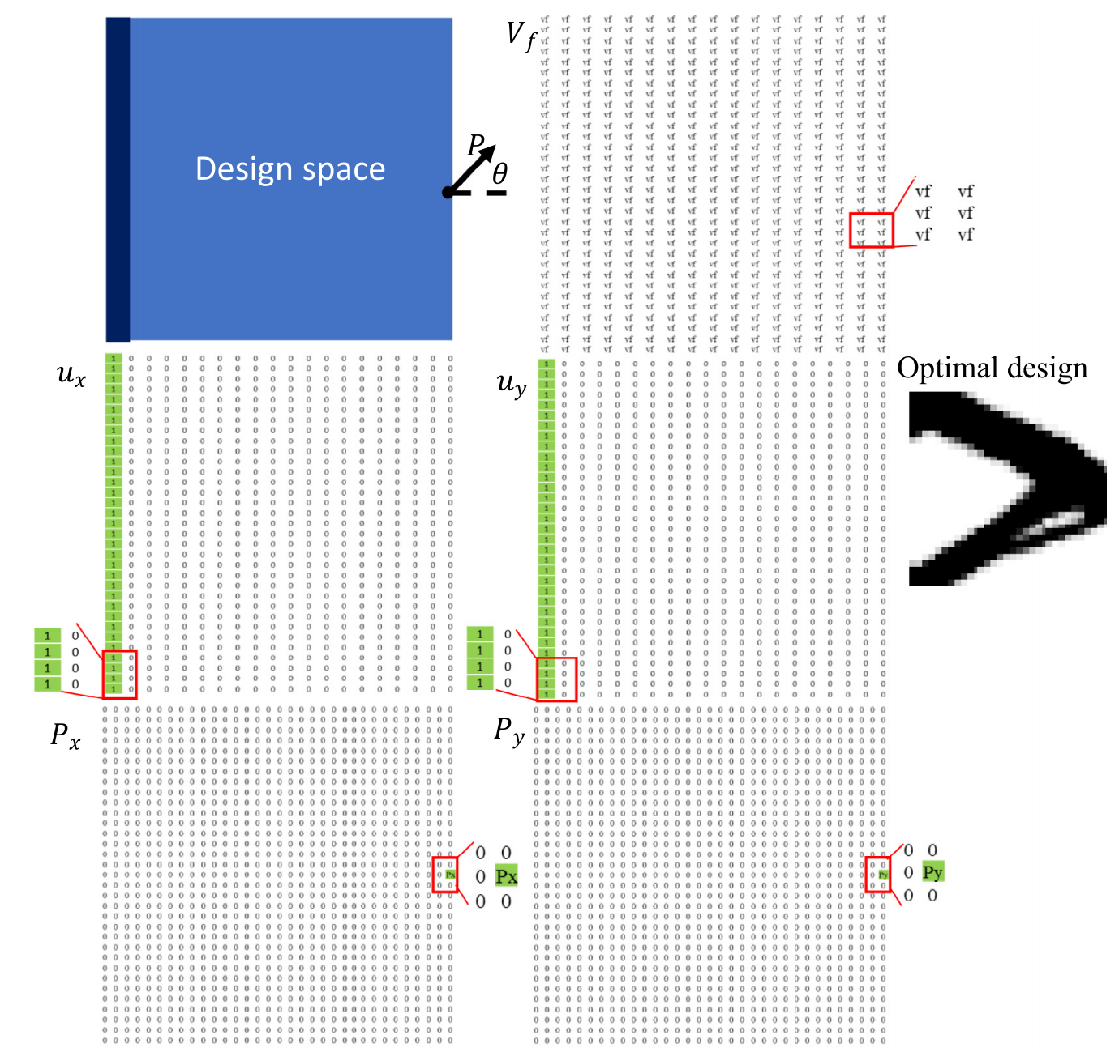
Arrange
Figure. Demonstration of the different channels.

Slide 14
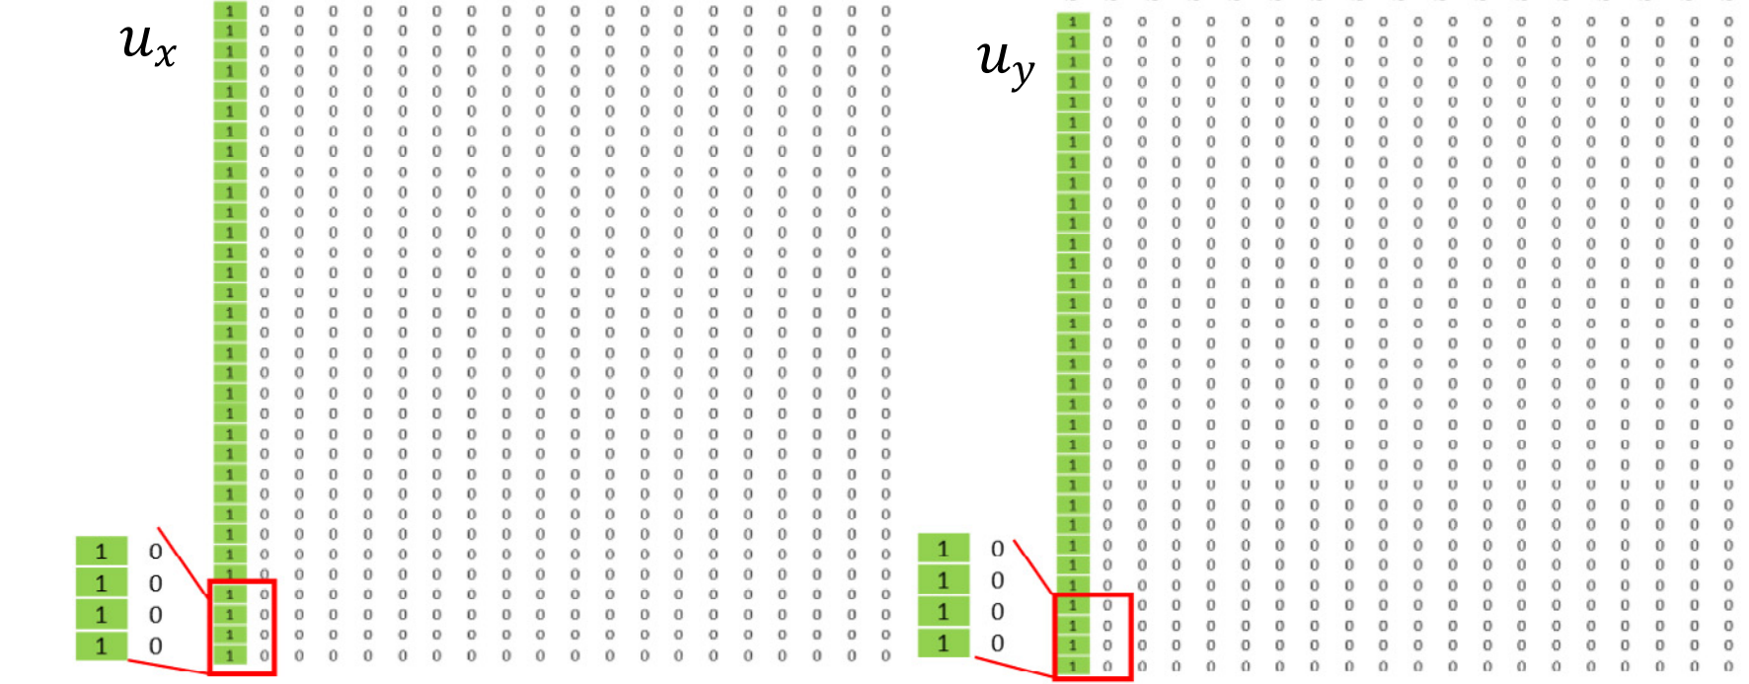
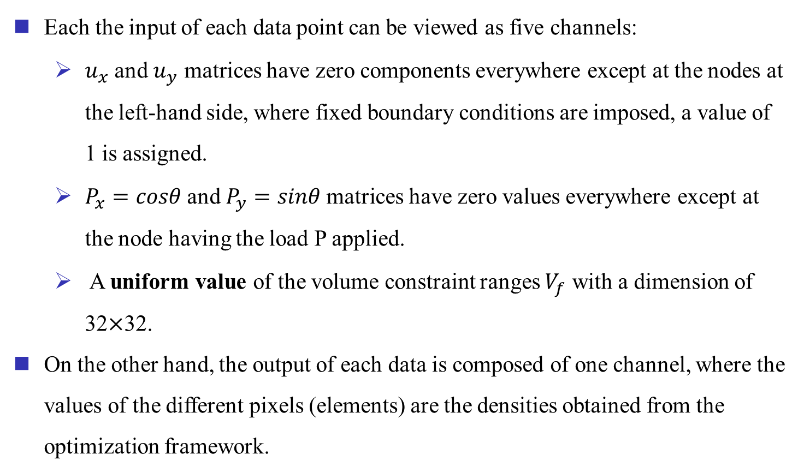
Arrange
Each the input of each data point can be viewed as five channels:
$u_{x}$ and $u_{y}$ matrices have zero components everywhere except at the nodes at the left-hand side, where fixed boundary conditions are imposed, a value of 1 is assigned.
$P_{x}=cosθ$and $P_{y}=sinθ$matrices have zero values everywhere except at the node having the load P applied.
A uniform value of the volume constraint ranges $V_{f}$ with a dimension of 32$×$32.
On the other hand, the output of each data is composed of one channel, where the values of the different pixels (elements) are the densities obtained from the optimization framework.

Slide 15
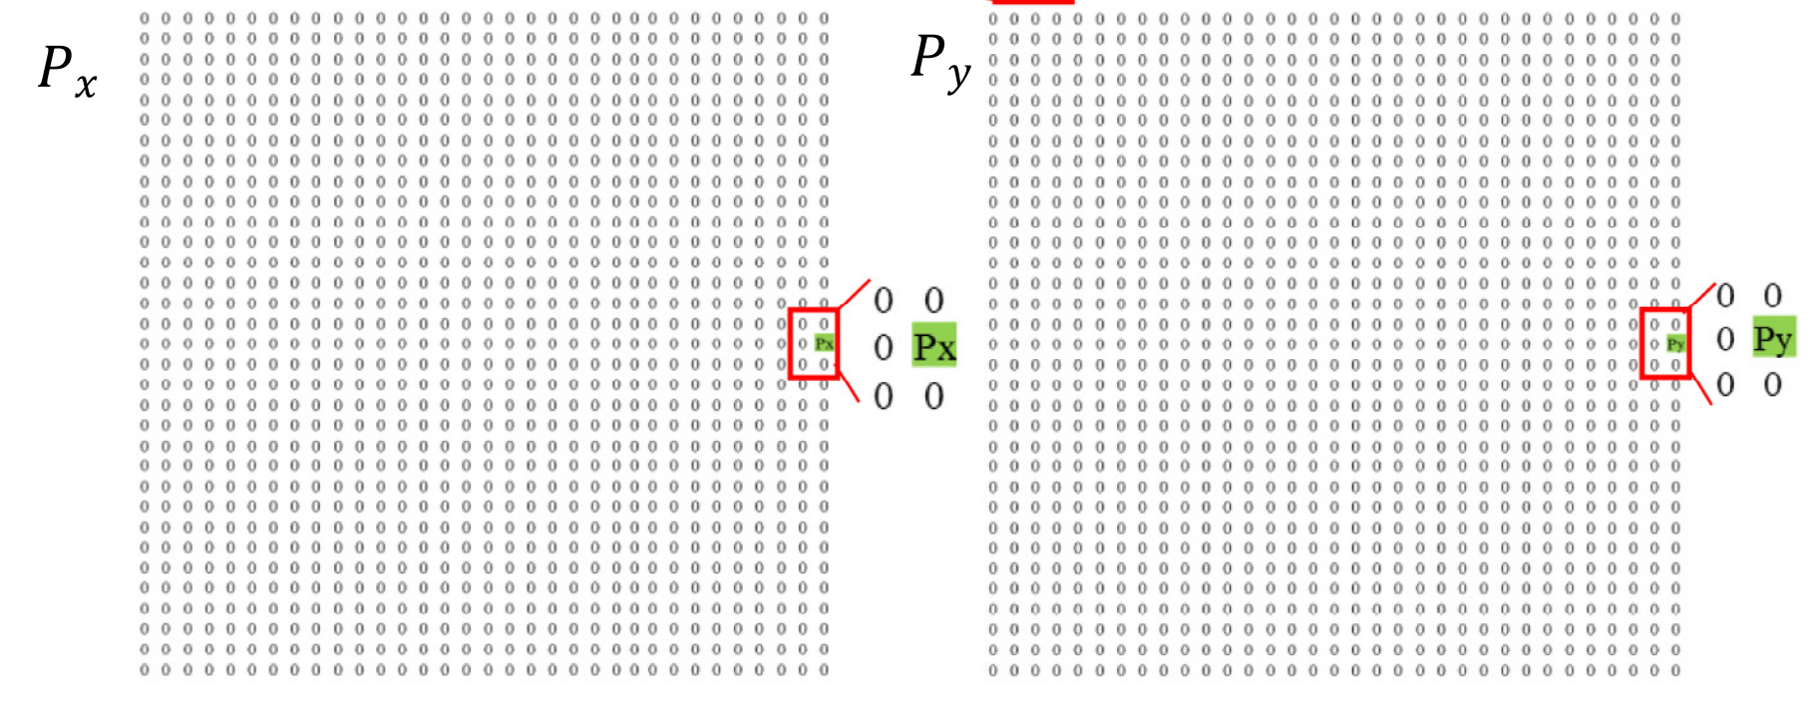
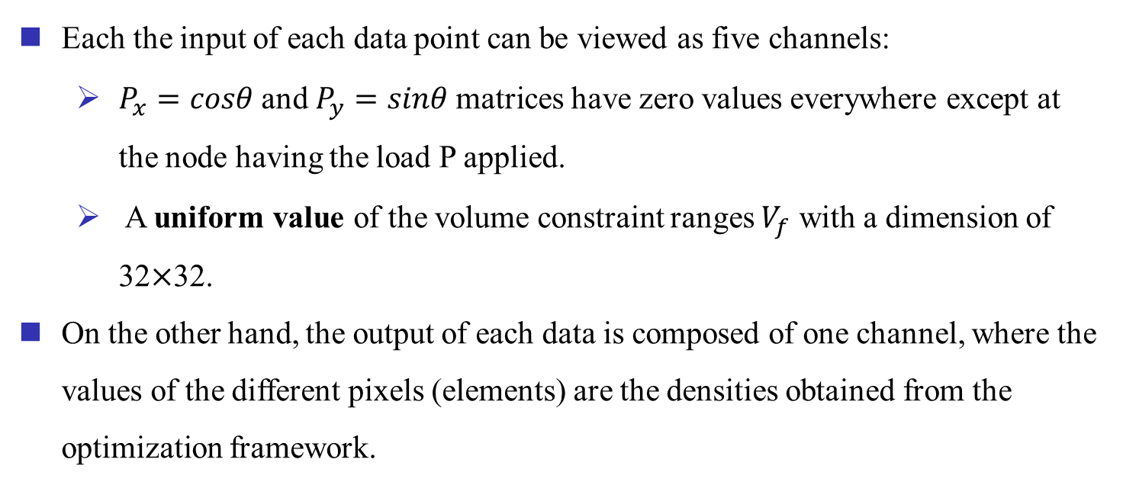
Arrange
Each the input of each data point can be viewed as five channels:
$P_{x}=cosθ$and $P_{y}=sinθ$matrices have zero values everywhere except at the node having the load P applied.
A uniform value of the volume constraint ranges $V_{f}$ with a dimension of 32$×$32.
On the other hand, the output of each data is composed of one channel, where the values of the different pixels (elements) are the densities obtained from the optimization framework.

Slide 16
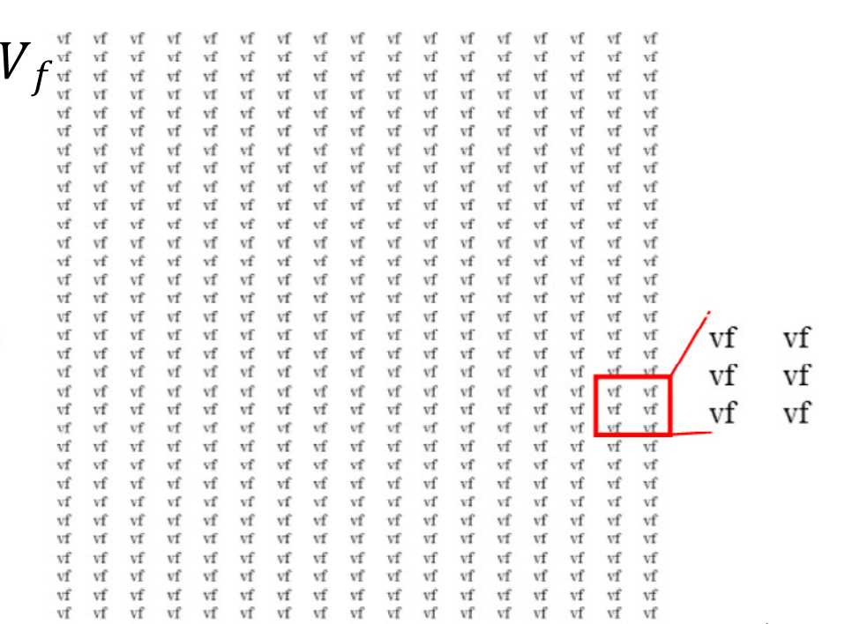
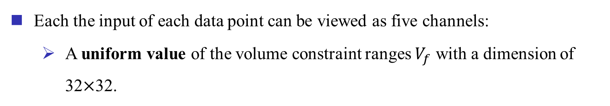
Arrange
Each the input of each data point can be viewed as five channels:
A uniform value of the volume constraint ranges $V_{f}$ with a dimension of 32$×$32.

Slide 17
Arrange
Each the input of each data point can be viewed as five channels:
$u_{x}$ and $u_{y}$ matrices have zero components everywhere except at the nodes at the left-hand side, where fixed boundary conditions are imposed, a value of 1 is assigned.
$P_{x}=cosθ$and $P_{y}=sinθ$matrices have zero values everywhere except at the node having the load P applied.
A uniform value of the volume constraint ranges $V_{f}$ with a dimension of 32$×$32.
On the other hand, the output of each data is composed of one channel, where the values of the different pixels (elements) are the densities obtained from the optimization framework.

Slide 18
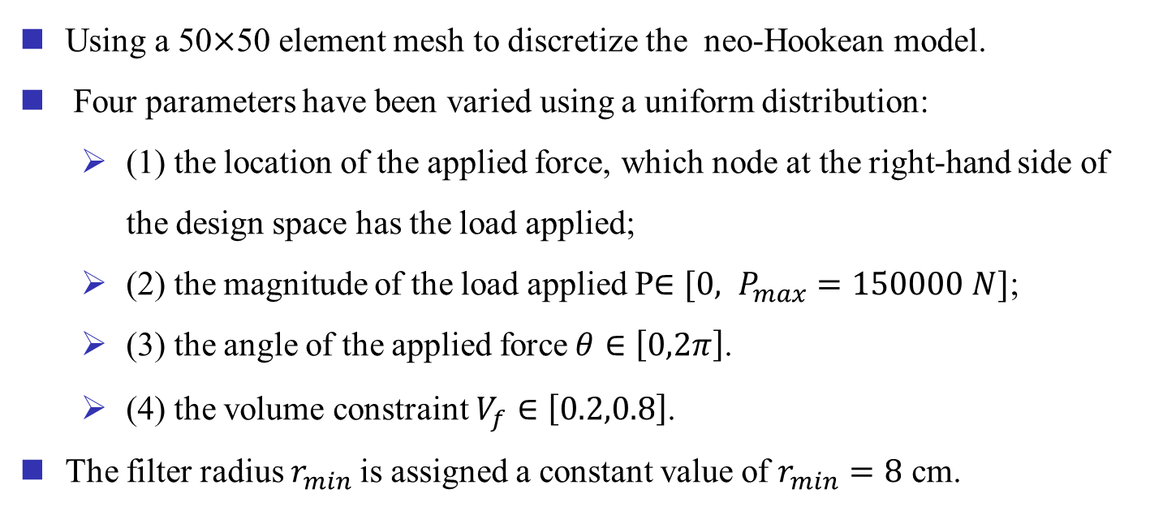
Dataset For Neo-Hookean Model
Using a 50$×$50 element mesh to discretize the neo-Hookean model.
Four parameters have been varied using a uniform distribution:
(1) the location of the applied force, which node at the right-hand side of the design space has the load applied;
(2) the magnitude of the load applied P$∈[0, P_{max}=150000 N]$;
(3) the angle of the applied force$θ∈\left[0,2π\right]$.
(4) the volume constraint$V_{f}∈\left[0.2,0.8\right]$.
The filter radius $r_{min}$is assigned a constant value of $r_{min}=8$ cm.

Slide 19
Further Steps
Eighteen thousand data points had been generated to train and test the developed CNN model.
The convergence condition for determining the size of the dataset is to achieve a dice similarity coefficient (DSC) higher than 0.95.

Slide 20
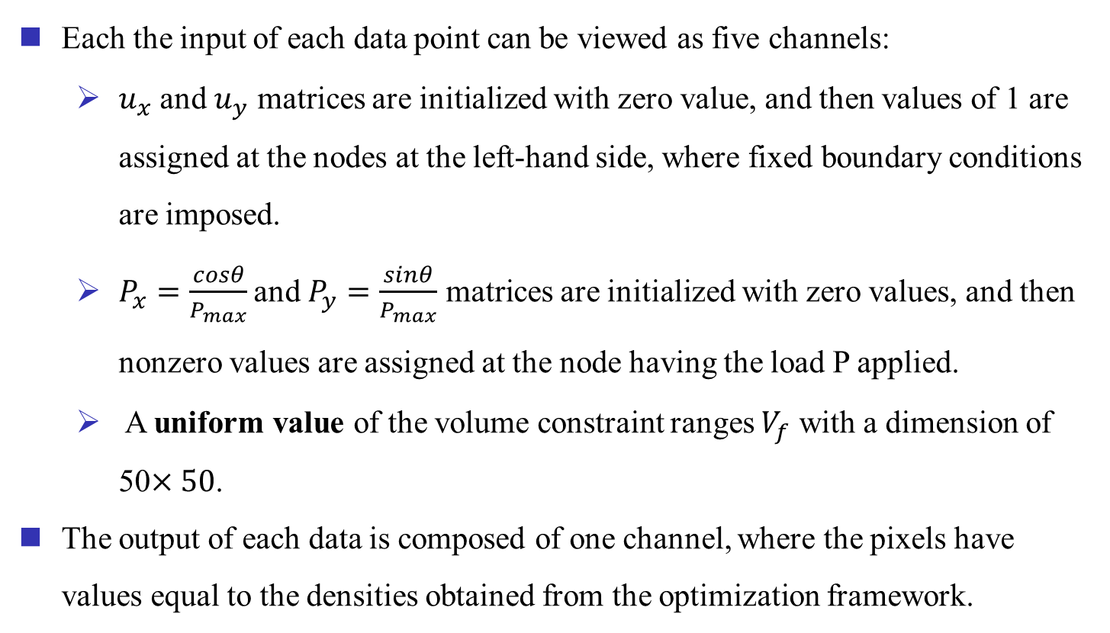
Arrange
Each the input of each data point can be viewed as five channels:
$u_{x}$ and $u_{y}$ matrices are initialized with zero value, and then values of 1 are assigned at the nodes at the left-hand side, where fixed boundary conditions are imposed.
$P_{x}=\frac{cosθ}{P_{max}}$and $P_{y}=\frac{sinθ}{P_{max}}$ matrices are initialized with zero values, and then nonzero values are assigned at the node having the load P applied.
A uniform value of the volume constraint ranges $V_{f}$ with a dimension of 50$×50$.
The output of each data is composed of one channel, where the pixels have values equal to the densities obtained from the optimization framework.

Slide 21
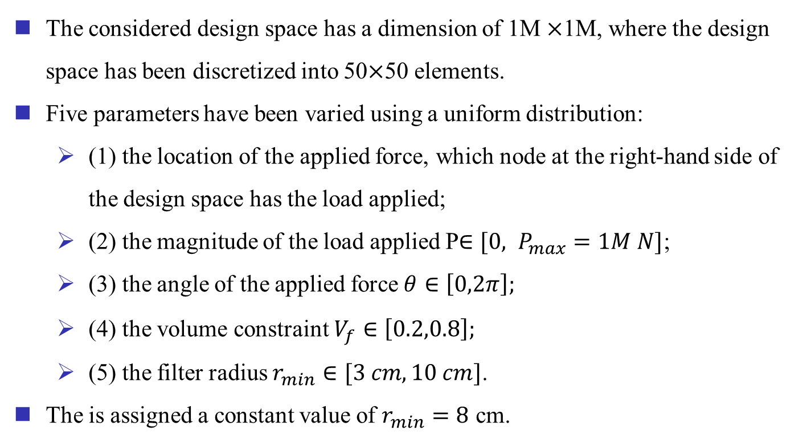
Dataset For Stress-based Model
The considered design space has a dimension of 1M $×$1M, where the design space has been discretized into 50$×$50 elements.
Five parameters have been varied using a uniform distribution:
(1) the location of the applied force, which node at the right-hand side of the design space has the load applied;
(2) the magnitude of the load applied P$∈[0, P_{max}=1M N]$;
(3) the angle of the applied force$θ∈\left[0,2π\right];$
(4) the volume constraint$V_{f}∈\left[0.2,0.8\right];$
(5) the filter radius $r_{min}∈[3 cm, 10 cm]$.
The is assigned a constant value of $r_{min}=8$ cm.

Slide 22
Further Steps
Twenty thousand data points had been generated to train and test the developed CNN model.
The convergence condition for determining the size of the dataset is to achieve a dice similarity coefficient (DSC) higher than 0.95.

Slide 23
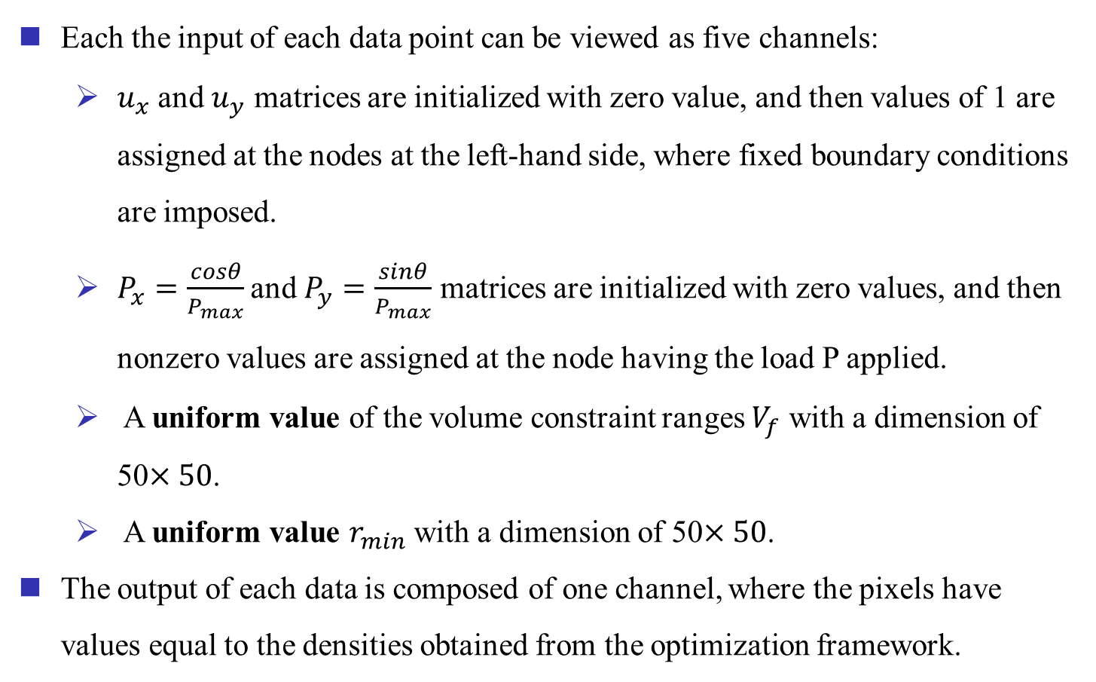
Arrange
Each the input of each data point can be viewed as five channels:
$u_{x}$ and $u_{y}$ matrices are initialized with zero value, and then values of 1 are assigned at the nodes at the left-hand side, where fixed boundary conditions are imposed.
$P_{x}=\frac{cosθ}{P_{max}}$and $P_{y}=\frac{sinθ}{P_{max}}$ matrices are initialized with zero values, and then nonzero values are assigned at the node having the load P applied.
A uniform value of the volume constraint ranges $V_{f}$ with a dimension of 50$×50$.
A uniform value $r_{min}$ with a dimension of 50$×50$.
The output of each data is composed of one channel, where the pixels have values equal to the densities obtained from the optimization framework.

Slide 24
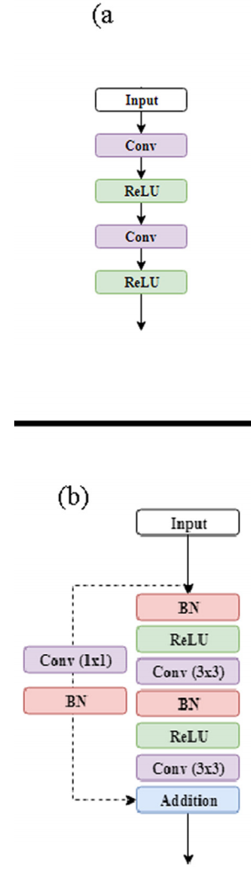
ResUnet Architecture
The ResUnet is a semantic segmentation convolutional neural network combining the privileges of the U-net and residual learning to improve the performance of U-net further.
U-net concatenates feature maps from different levels to improve segmentation accuracy.
The primary difference between the employed ResUnet and conventional U-net is the use of residual units instead of plain neural units as building blocks for the developed network.

Slide 25
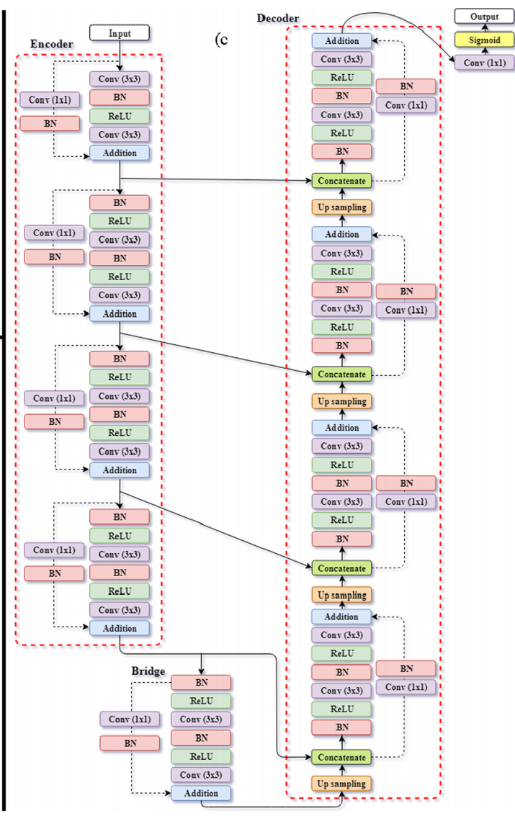
ResUnet Architecture
The ResUnet is composed of three components:
(1) Encoder, encodes input images into compact representation,
(2) Decoder, retrieves the encoded representations to a pixel-wise categorization (semantic segmentation),
(3) Bridge, connects the encoder and decoder.

Slide 26
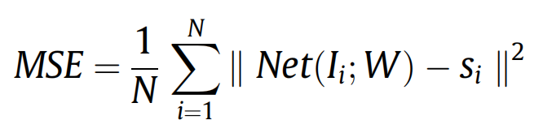
Loss Function
The models were developed and tested using Keras.
Utilizing mini-batching to increase the convergence rate and assist the CNN models to escape from local minima.
The same hyperparameters are used for the three cases:
the batch size of 64, the number of epochs of 150, and the learning rate of 0.01.
Using Adam optimizer, which is a gradient-based stochastic optimization algorithm to train the models.
Using the mean square error as loss function:
N is the number of training examples.

Slide 27
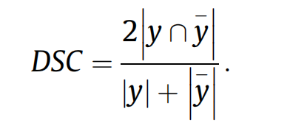
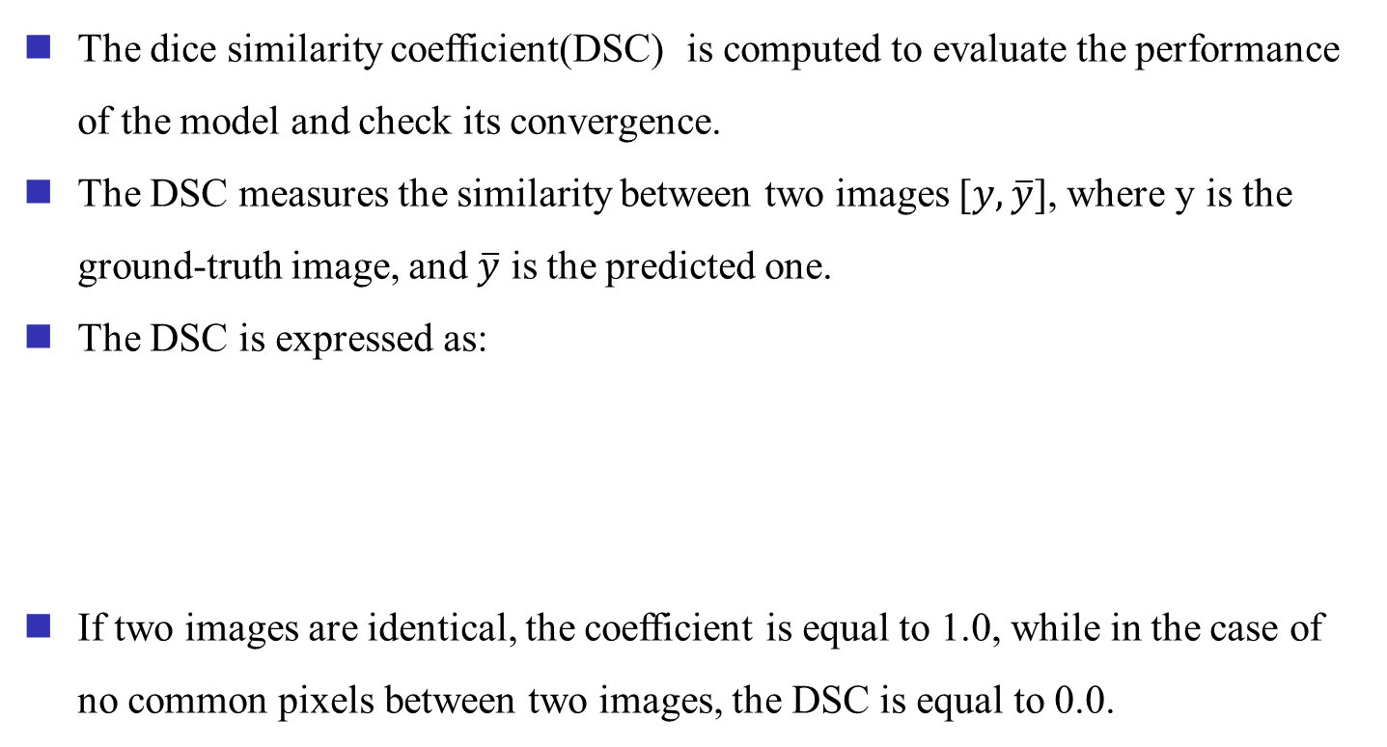
Model Evaluation
The dice similarity coefficient(DSC) is computed to evaluate the performance of the model and check its convergence.
The DSC measures the similarity between two images [$y,\overline{y}$], where y is the ground-truth image, and $\overline{y}$ is the predicted one.
The DSC is expressed as:
If two images are identical, the coefficient is equal to 1.0, while in the case of no common pixels between two images, the DSC is equal to 0.0.

Slide 28
Contents
1
Background
2
Motivation
3
Proposed Method
4
Experimental Results
5
Conclusion

Slide 29
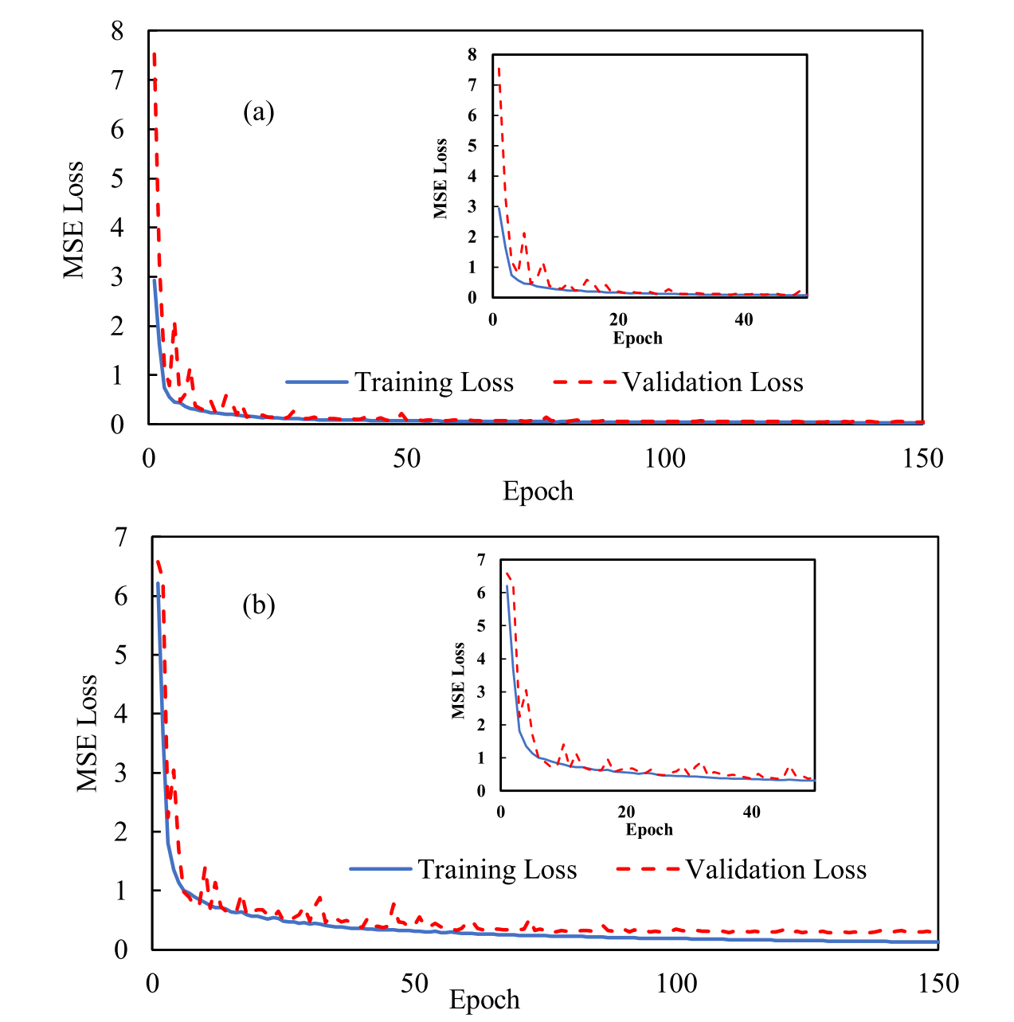
MSE Loss
Figure. The convergence history of the loss function for the CNN model developed for the case of (a) linear elasticity with small deformation and (b) geometric and material nonlinearities.

Slide 30
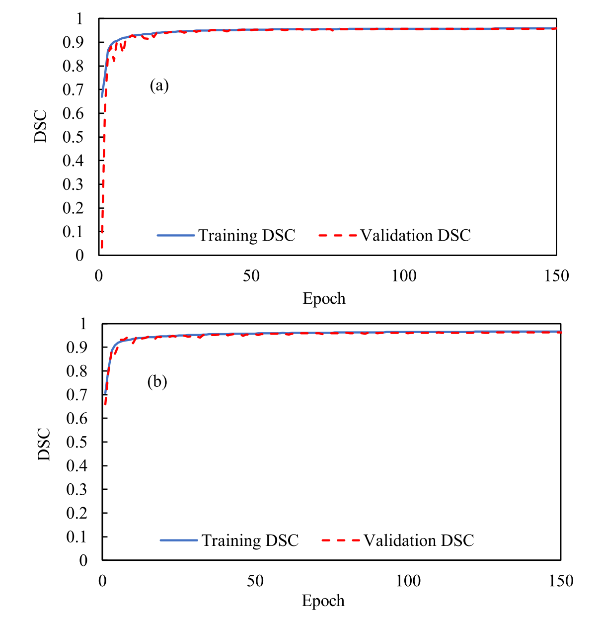
DSC
Figure. The convergence history of the DSC for the CNN model developed for the case of (a) linear elasticity with small deformation and (b) geometric and material nonlinearities.

Slide 31
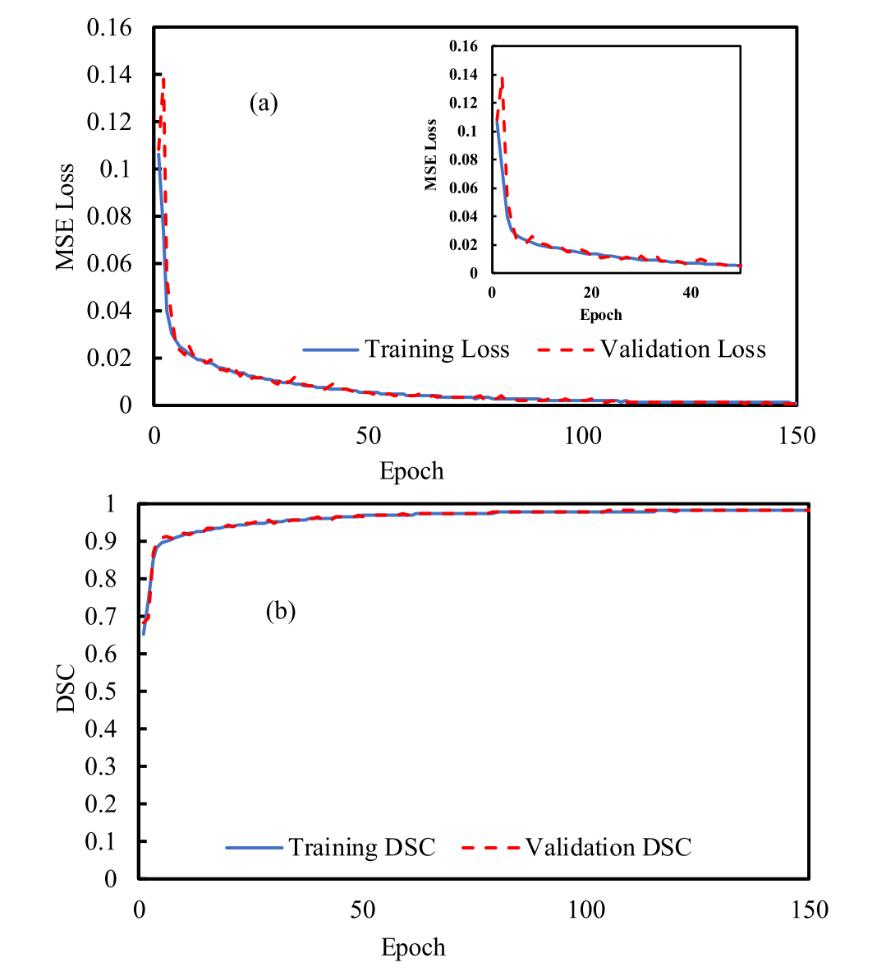
MSE Loss & DSC
Figure. The convergence history of the CNN model developed for the case of linear elasticity under stress constraint: (a) loss history and (b) DSC history.

Slide 32
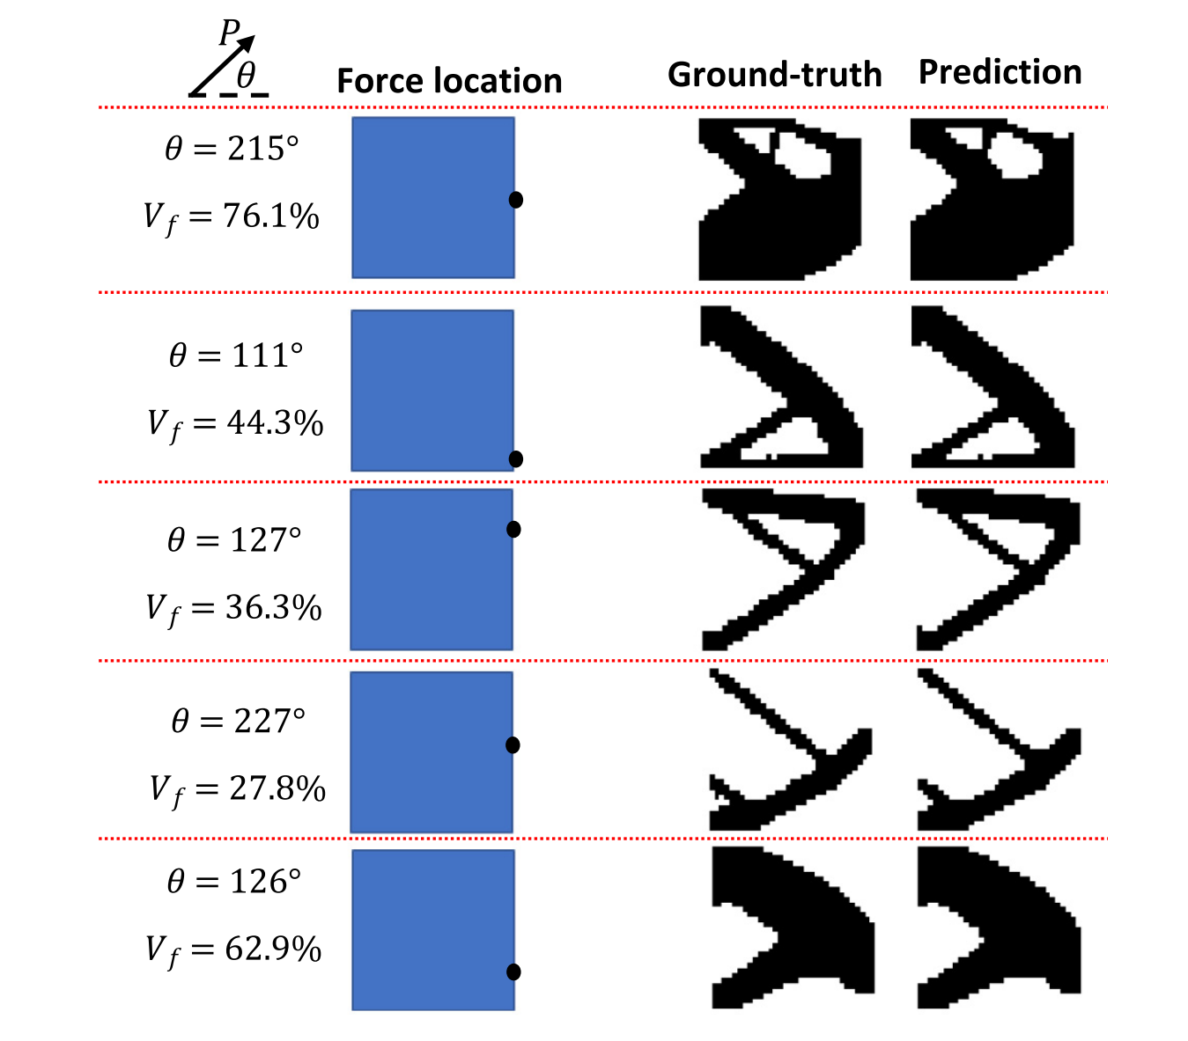
Comparison
Figure. Comparison between optimized designs for the case of linear elasticity with small deformation. The design space has a dimension of 1 m$×$1 m.

Slide 33
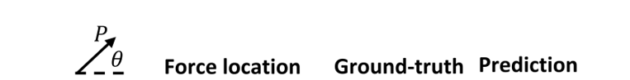
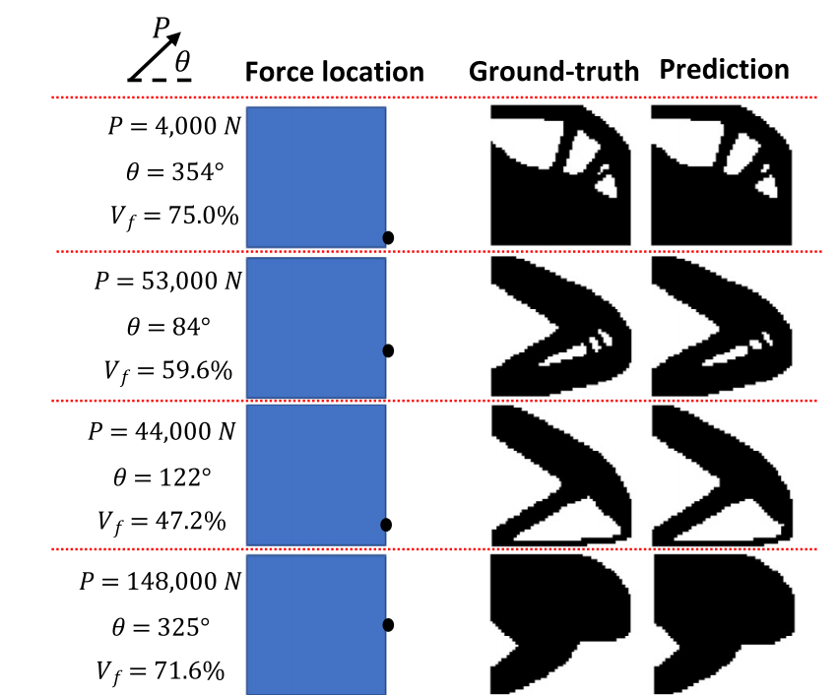
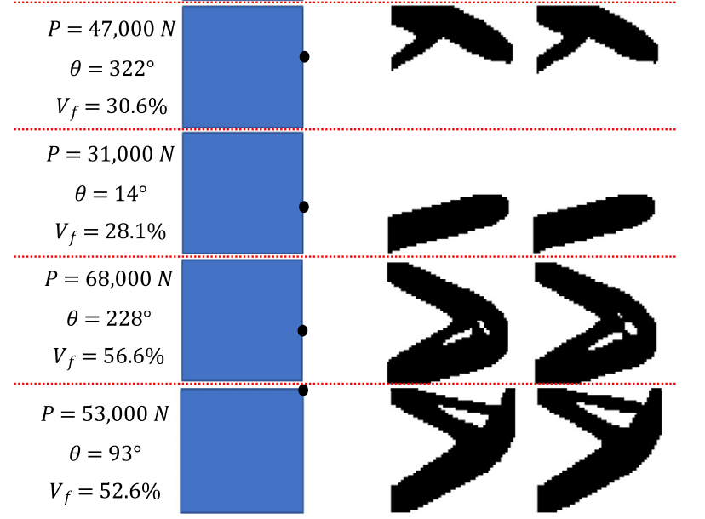
Comparison
Figure. Comparison between optimized designs for the case of nonlinear elasticity
with finite deformation. The design space has a dimension of 1 m$×$1 m.

Slide 34
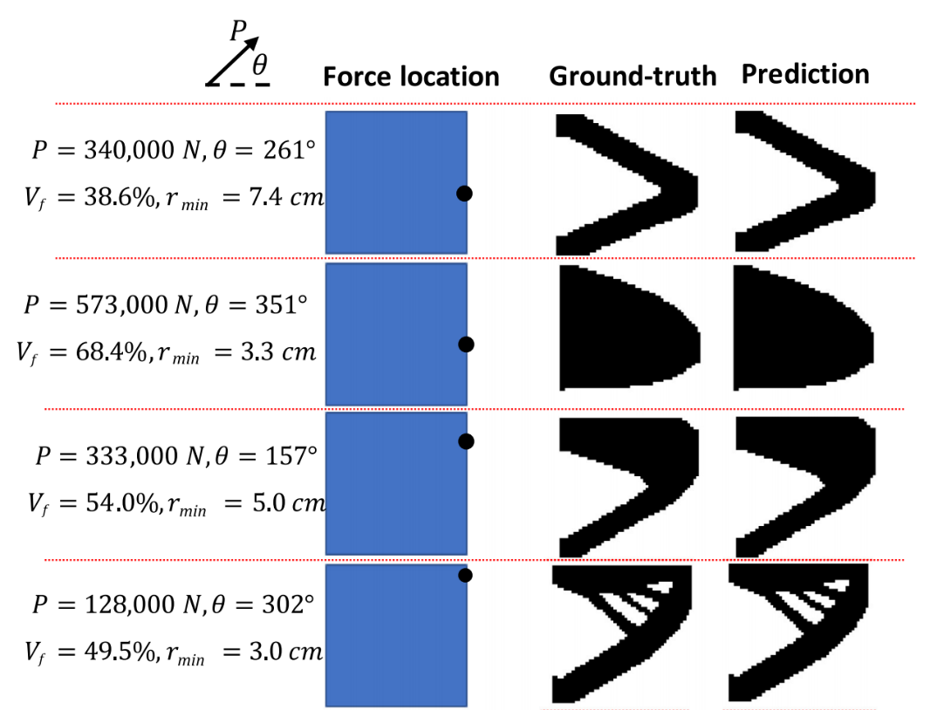
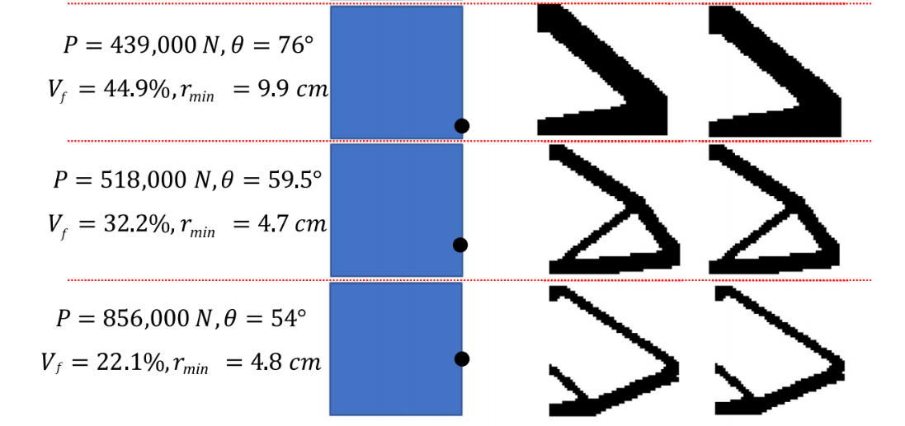
Comparison
Figure. Comparison between optimized designs for the case of linear elasticity under stress constraint. The design space has a dimension of 1 m$×$1 m.

Slide 35
Contents
1
Background
2
Motivation
3
Proposed Method
4
Experimental Results
5
Conclusion

Slide 36
Conclusion
Contributions
Develop three CNN models to predict the optimized designs in three cases.
The developed machine learning models are robust, and they are in an excellent agreement with the results obtained from the mathematically rigorous nonlinear topology optimization frameworks, which require an expensive computational cost.

Slide 37
Thank You
Thank You
Q&A

